Slide 1

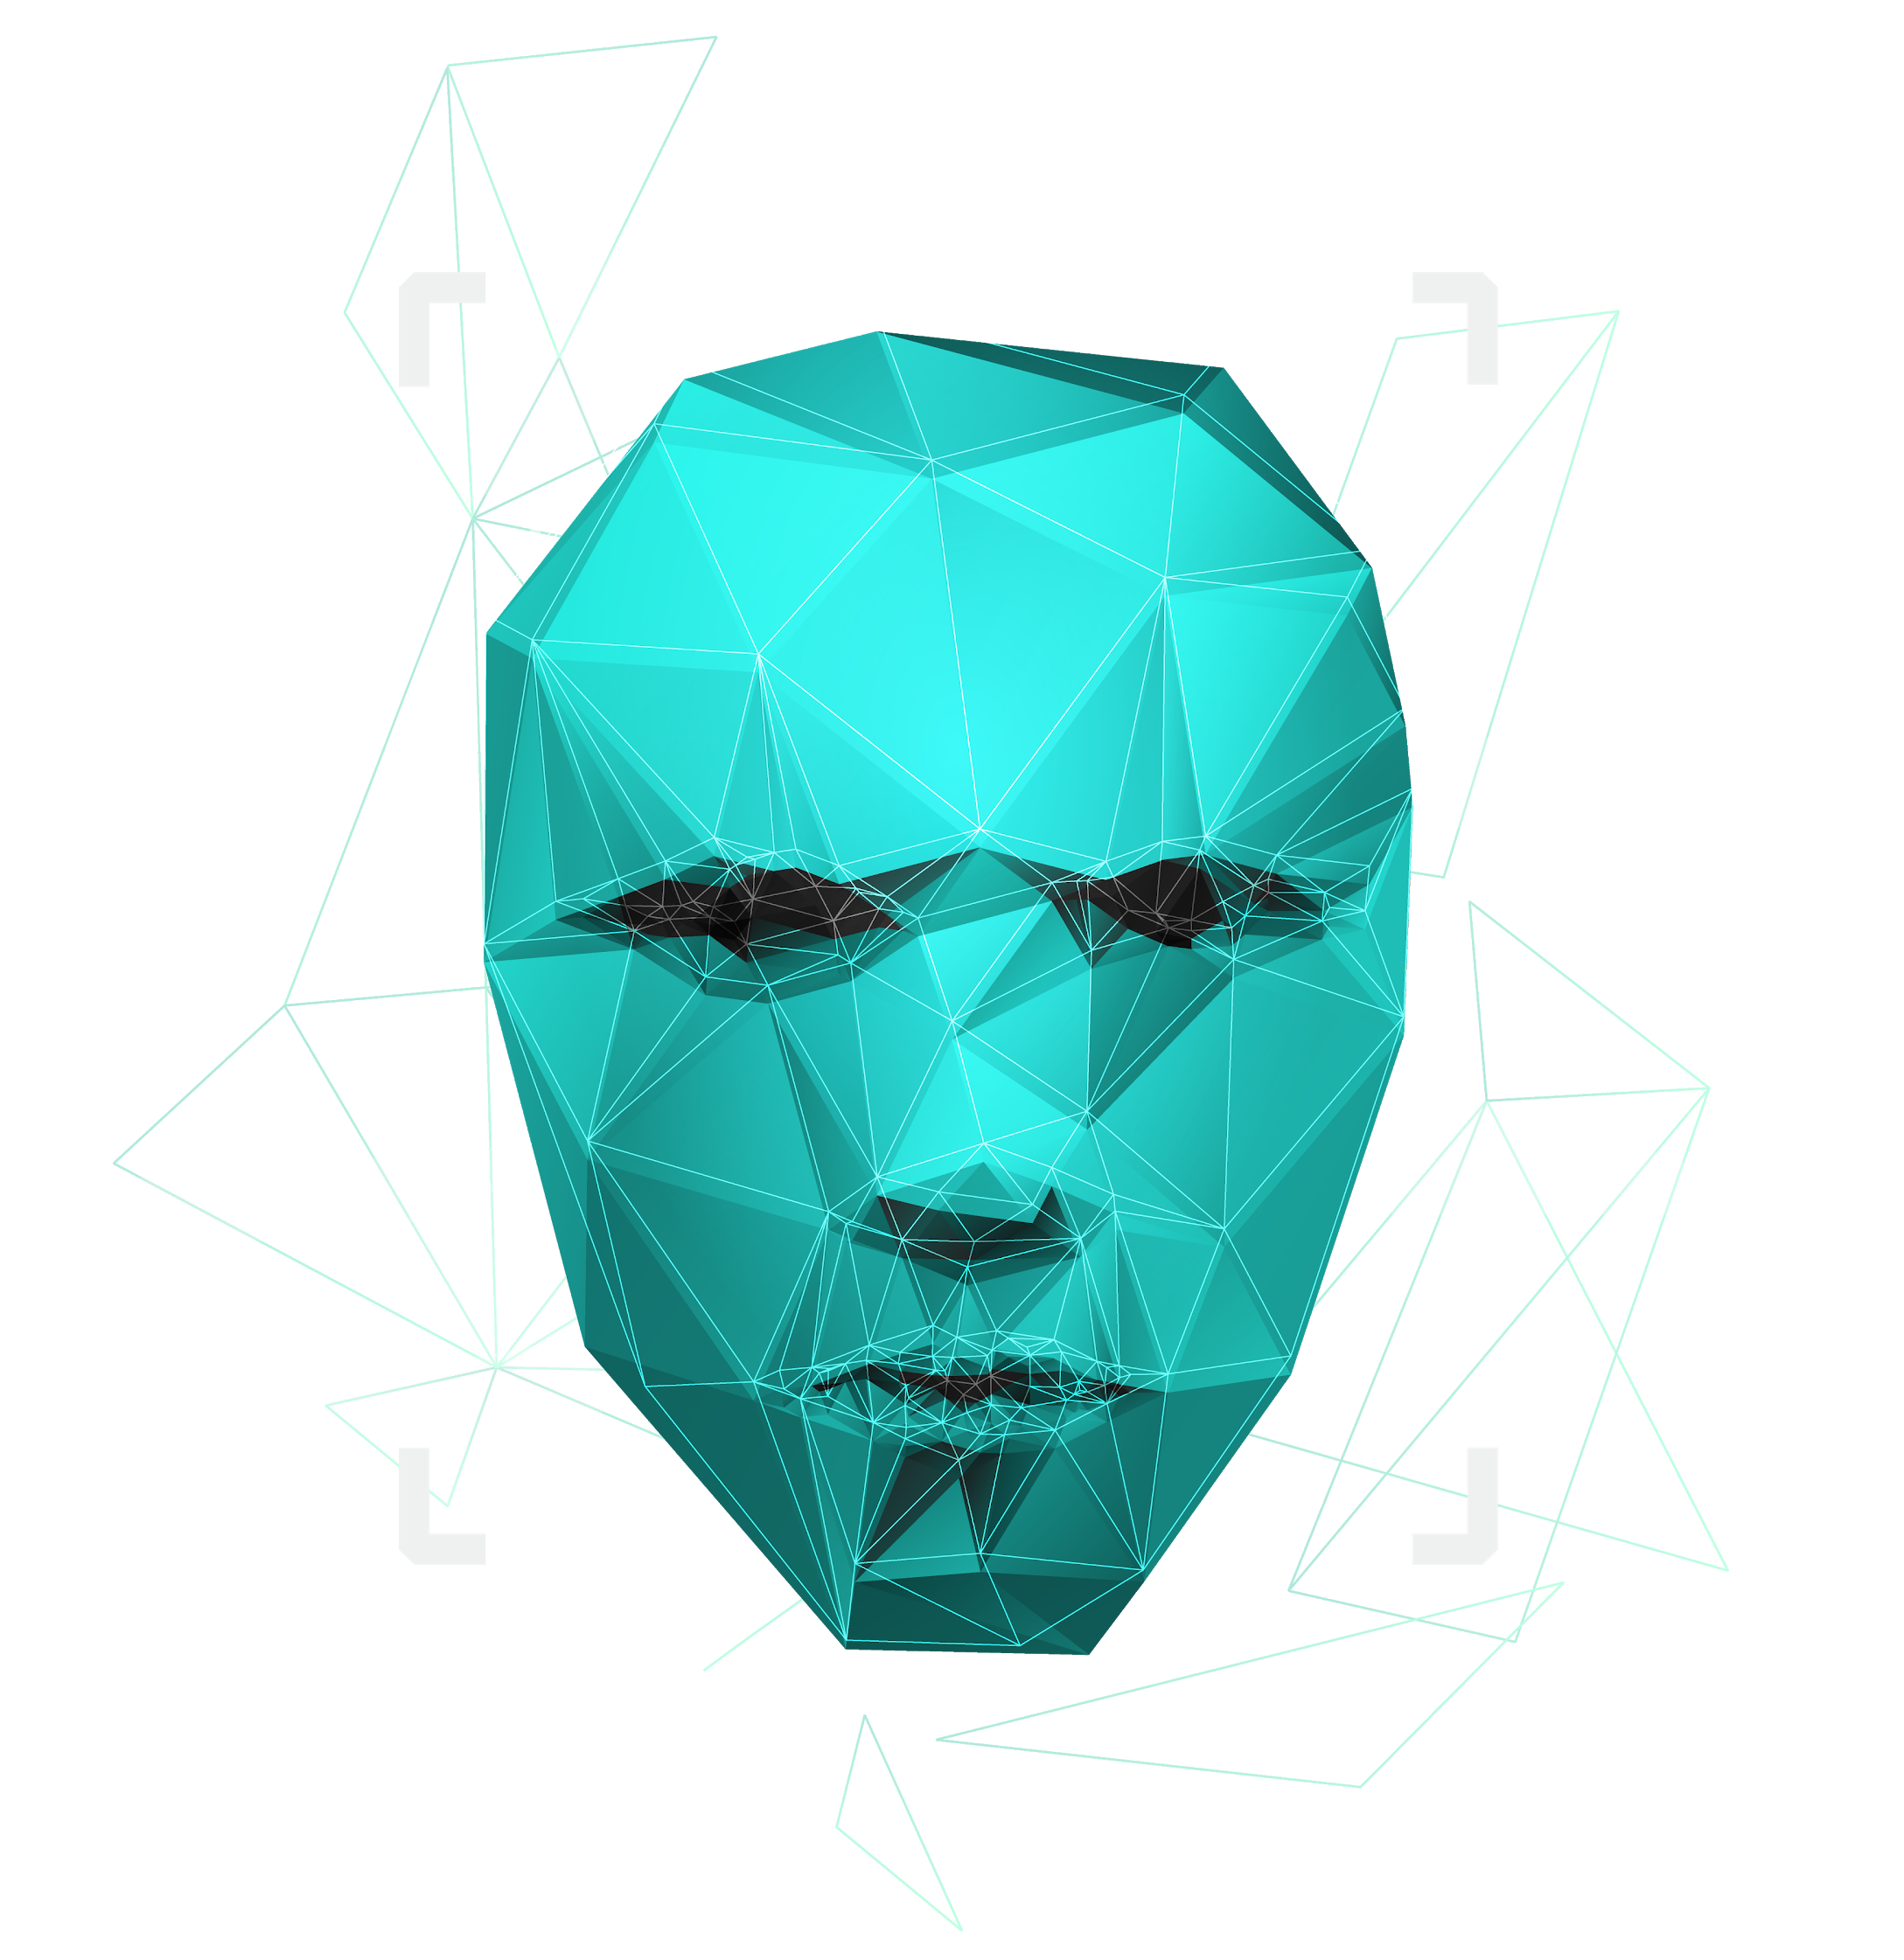
Paternity testing using genetics
Supervised by : Dr. Ashraf Abdelraouf & Eng. Ahmed Hazem

Slide 2

Agenda
Introduction & Objectives
Problem Statement
System Overview
Methodology
Design Patterns
Diagrams
Dataset Description
User Interface
Results
Time plan
Demo

Slide 3

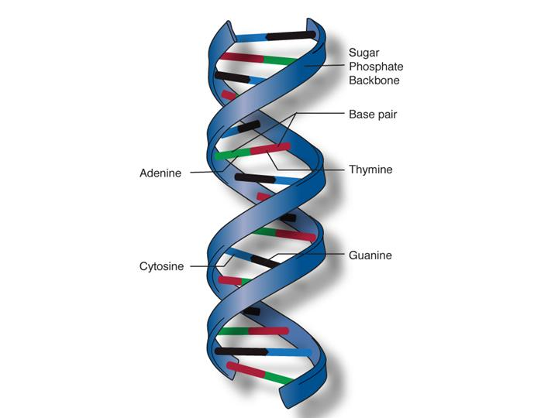
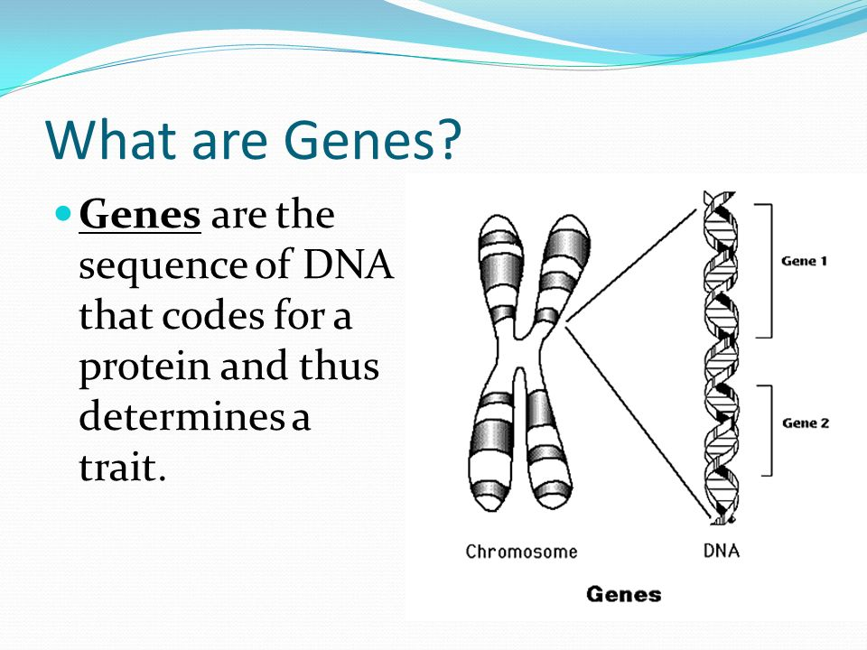
Introduction
DNA
DNA molecules allow this information to be passed from one generation to the next.
Genes →Genes are passed from parents to offspring and contain the information needed to specify traits(qualities). Genes contains a subset of the DNA and this subset is (A, T, C, G).

Slide 4
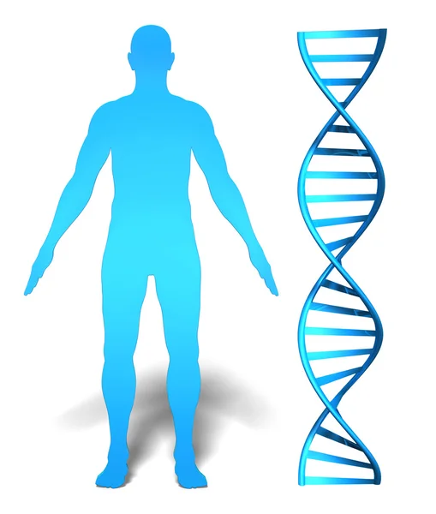
Introduction (cont.)
Whole genome
It is the whole DNA sequence that a human have in their system.
Whole exome
It is a part of the whole genome and makes up to 1.5% of it and it may reveal information about family relationships (ex: paternity test)

Slide 5
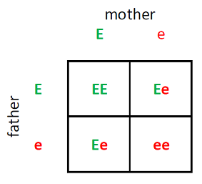
Introduction (cont.)
What is an rsNumebr?
It is a reference number to the gene we have that consists of two alleles (one from the father and the other from the mother).
EX:
RsNumber | Father | Mother | Child1 | Child2 | Child3
rs3131972 | AG | GG | AG | GG | GG

Slide 6


Problem Statement
Some parents suffer from the process of paternity testing when they are being sued for child custody.
A lot of time when a crime happens, some DNA would be left at the crime scene and would take some time to be processed and eventually lead us to the one who committed that crime.
Why can’t we have a system that could potentially prove this in less time and be accessible to everyone.

Slide 7
Our Objectives
Make an automated system to accurately prove parentage of someone by their rs numbers and their genotypes.
Add another part to enter the user’s whole genome .
Implement a section for relevance using rs numbers
We aim to have the application accessible by everyone by an online Mobile application.
We aim that the user can see which alleles contributed to being wrong that led to prove wrong parentage.

Slide 8
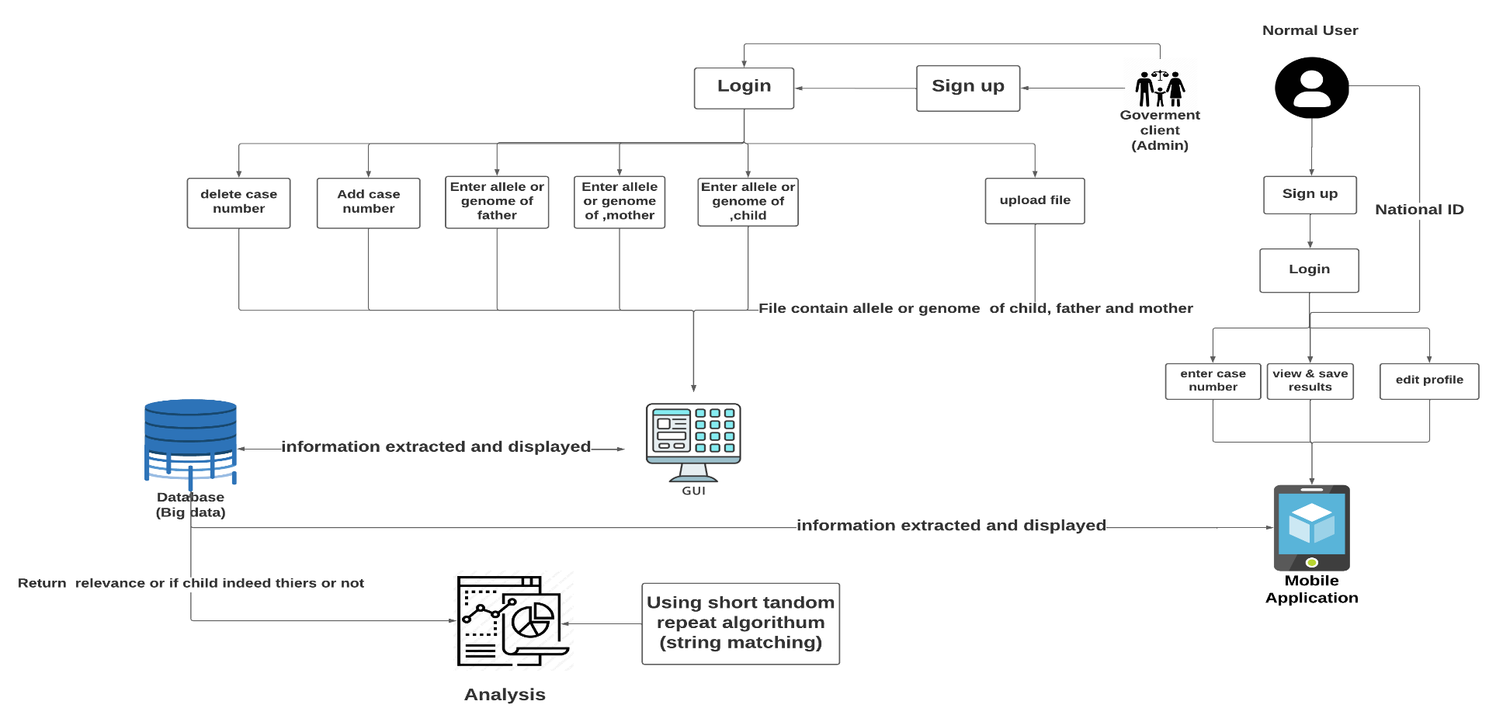
System overview

Slide 9
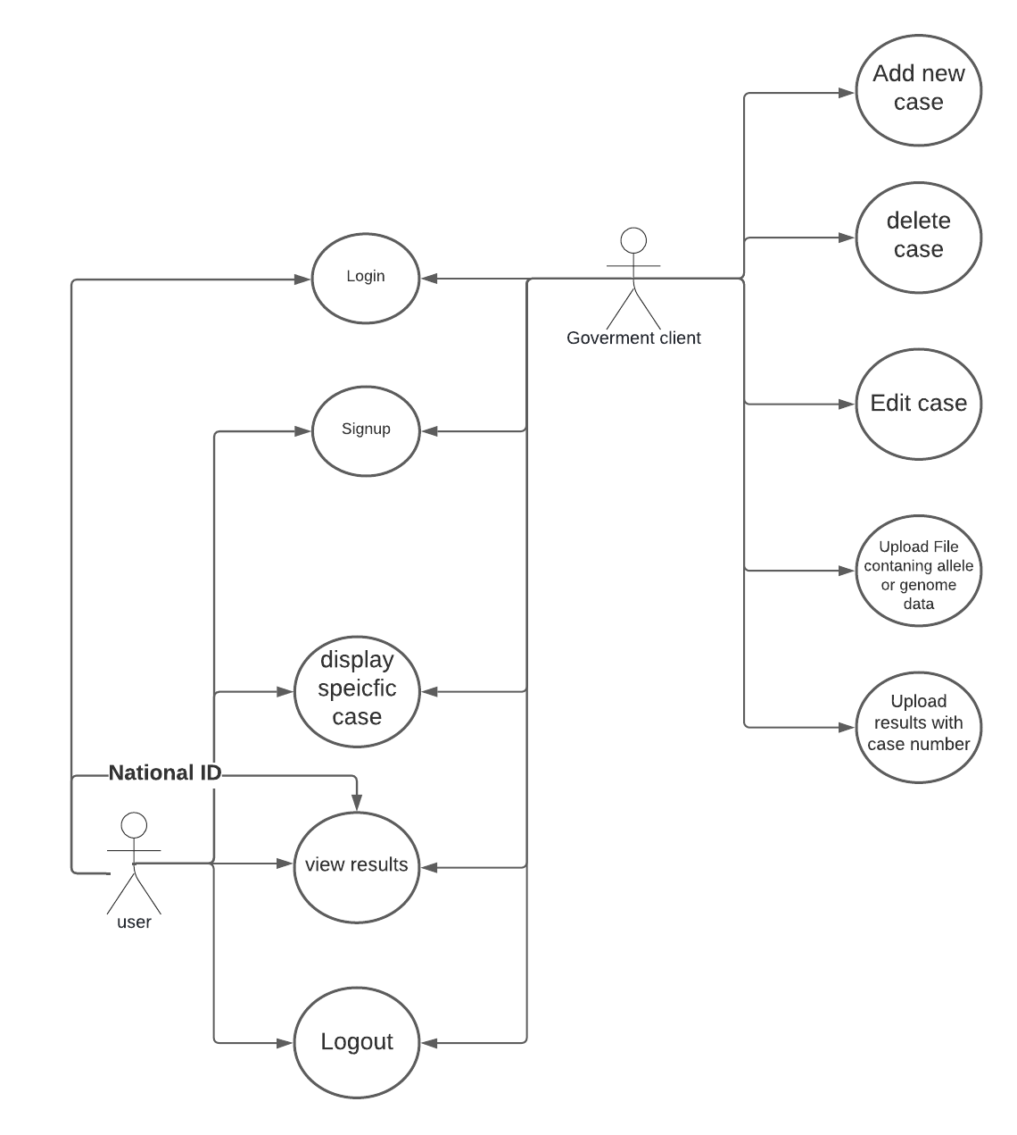
Use Case Diagram:
The system can accept files from the user containing their genotypes.
The system can save the user’s data (genotypes) (results)
The user can input their genotypes and get a report showing which genotypes contribute to the paternity test.
The user can see which alleles are different if it was proven wrong.
Rewrite this part

Slide 10
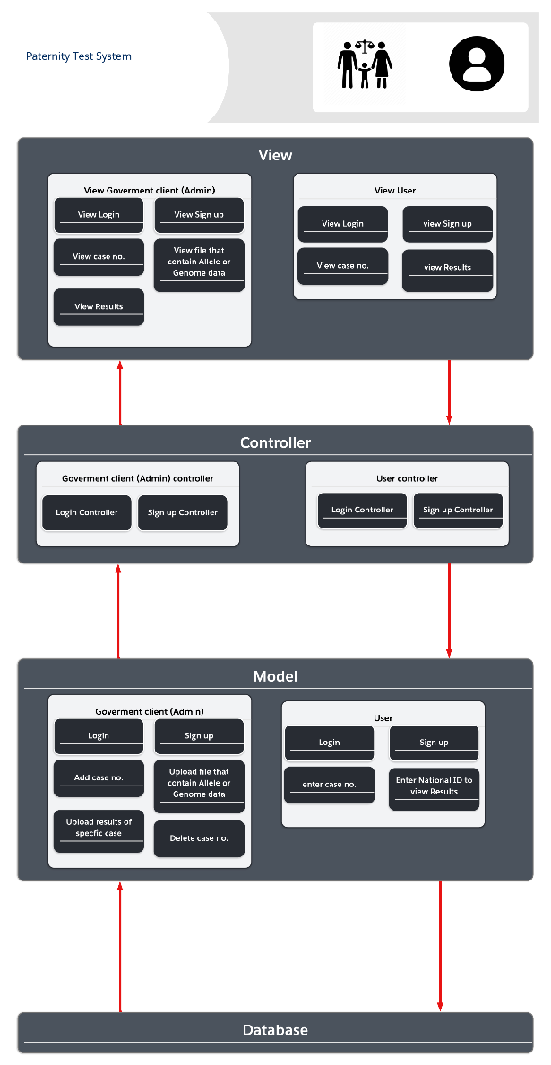
Diagrams Architecture Diagram

Slide 11
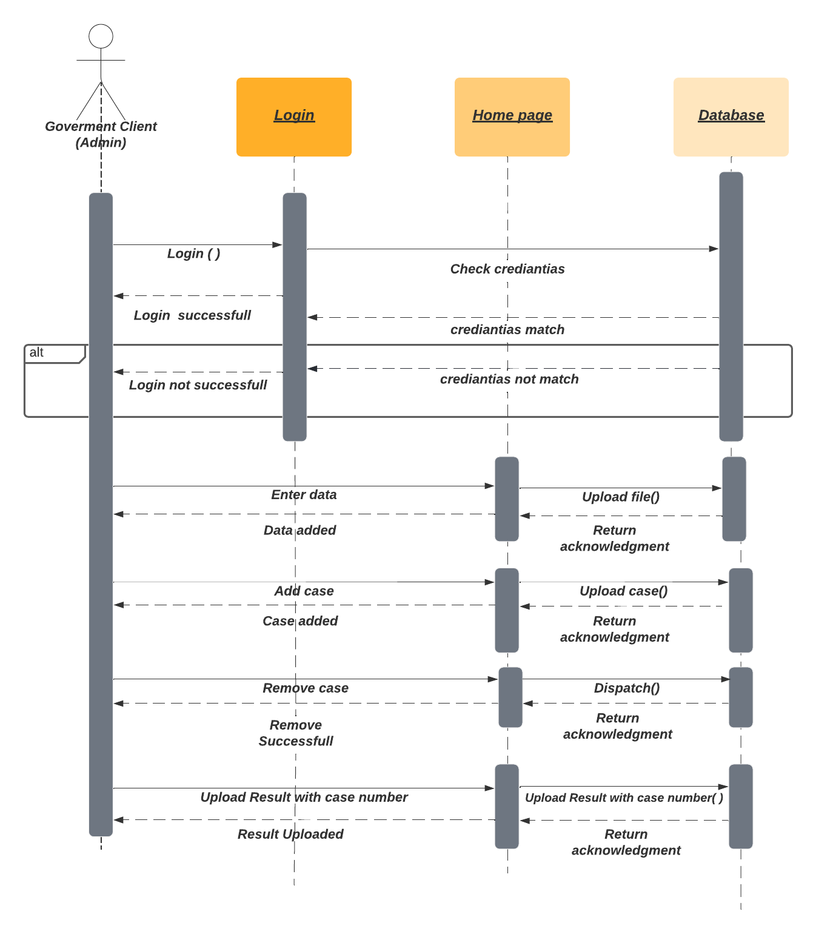
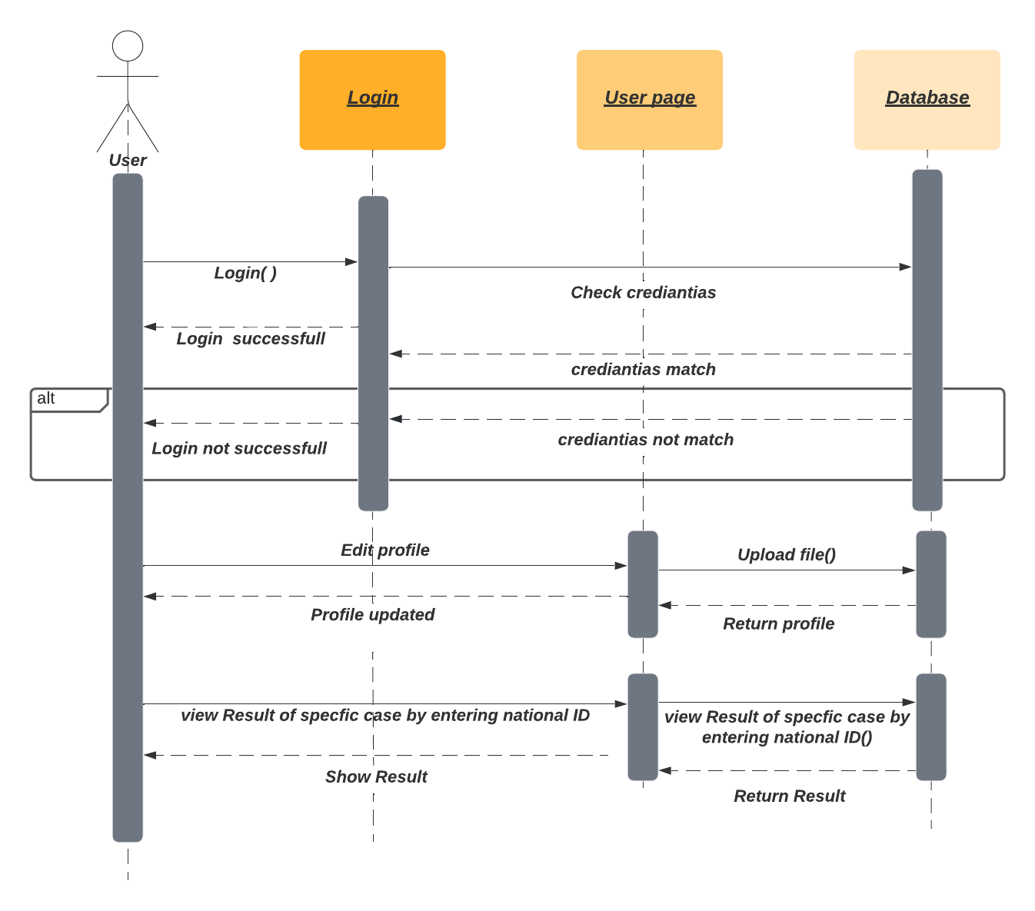
Diagrams (cont.) Sequence diagrams

Slide 12
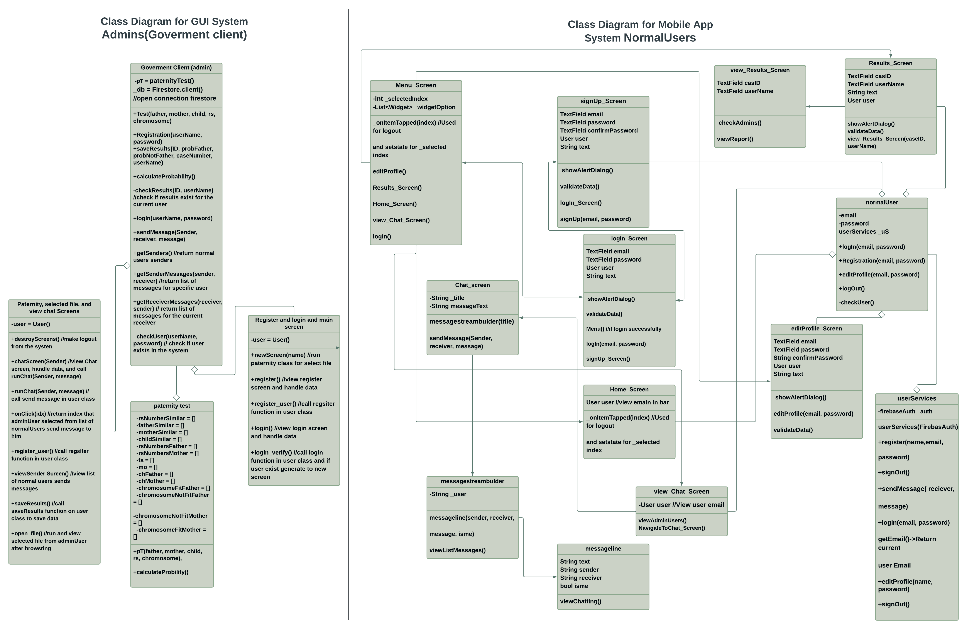
Diagrams (cont.)
Class diagram

Slide 13
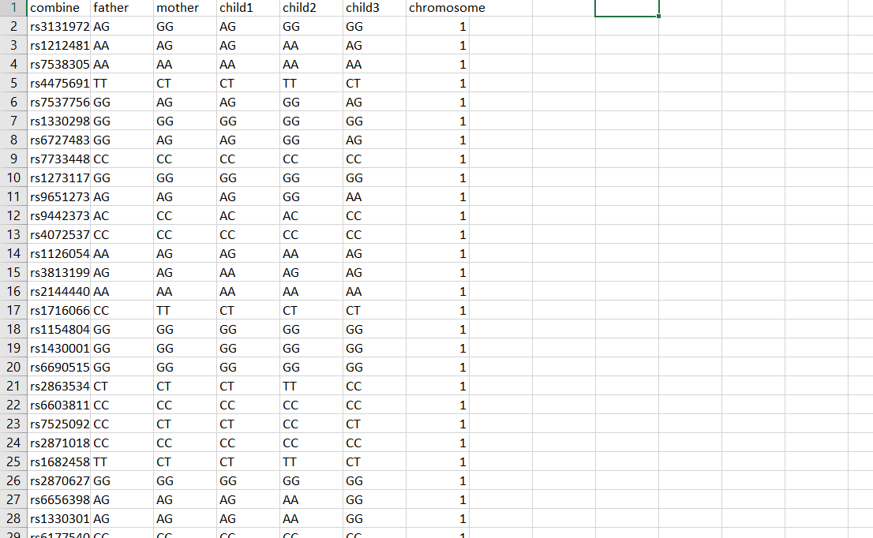
Dataset Used:
Our dataset has over 100000 instances of rs numbers and consists of 6 main features showing both alleles for every family member and the number of chromosome for each instance

Slide 14
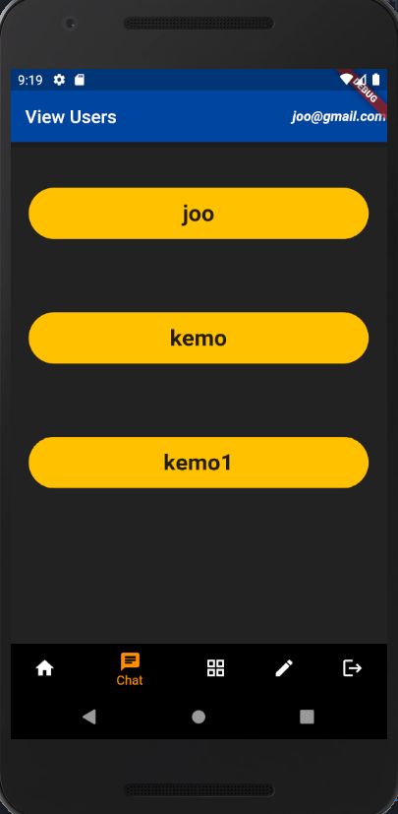
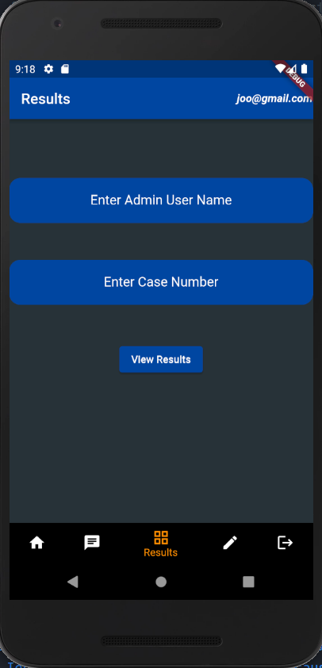
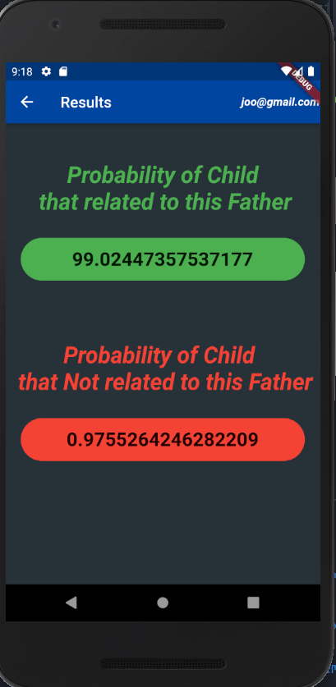
User interface

Slide 15
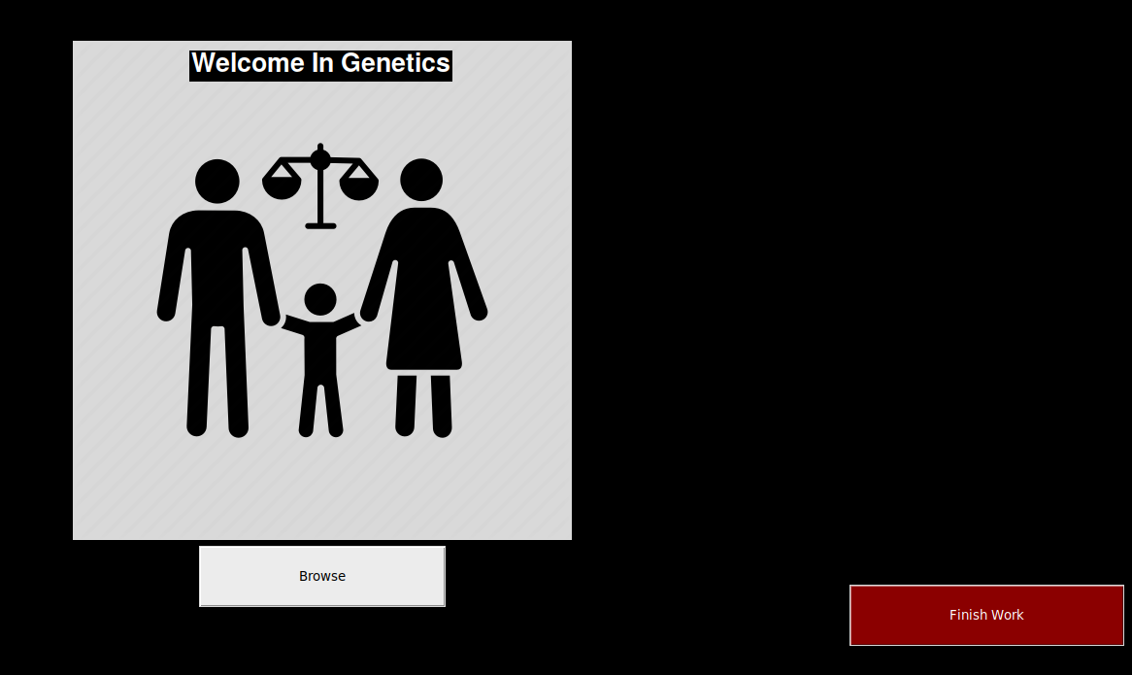
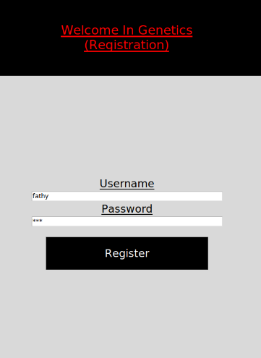
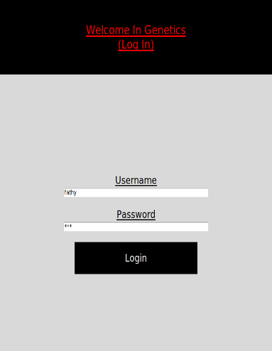
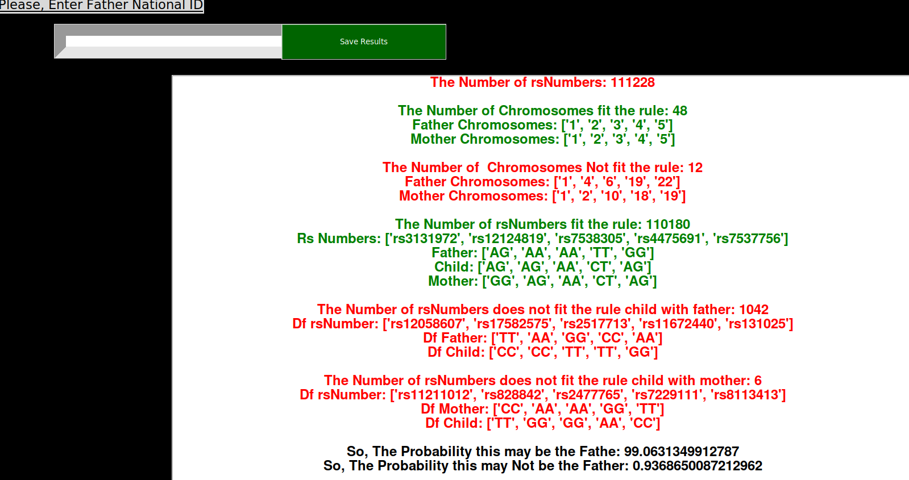
User interface (cont.)

Slide 16
TIME PLAN
13/1/2022
Enhance everything we implemented so far
Whole genome processing from the sources we gathered
By the end of January
Potentially add Whole exome in our system based on the information we gathered
By the end of February
Implement at least 60 % of the web application
Before the end of Februrary
Start by the end of February
Prove that if is at least a relevance or kinship degree

Slide 17
Live Demo

Slide 18
THANK You!
Do you have any questions? ☺

